Slide 1
A Convenient Method
Using Movement Data Sets – by Kevin Price

Slide 2
Outline
About the Speaker
Workflow
Questions to Address
Hypothesis
Ships by Port Report
Ports by Country Report
Summary/Conclusion

Slide 3






About the Speaker
Education:
Bachelor of Arts from the University of Alabama
Professional skills:
Finance and Banking
Hobbies:
Fantasy Football and Baseball
Podcasting
Long walks with my wife and dog
Movie nights with our cat
Kevin Price
Dallas, Texas
Kevin.Lee.Price@icloud.com
(850) 572-1371

Slide 4
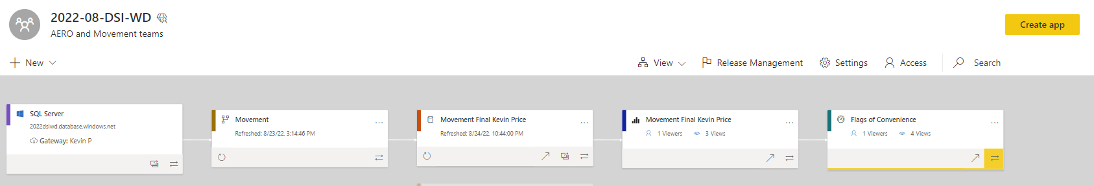
Workflow
Process Steps Taken:
SQL Server data imported and transitioned/prepared from flat file into Power Query
Dataset imported from SQL server into Dataflow
Dataset derived from Dataflow
Dataflow moved to Report – Visualizations created in PowerBI Desktop
Dashboard created to represent Visualizations created in PowerBI
(Q&A)

Slide 5
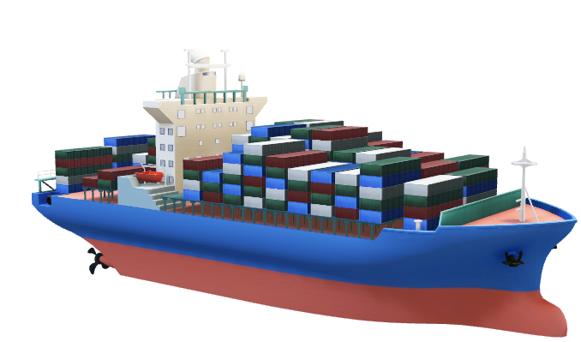
Question to Address
Does the number of ports available within a country reduce traffic and allow for a higher volume of ships to carry out transits?
Is there a correlation to the number of ships and a number of ports in a country?

Slide 6
Hypothesis
Data to Compare:
Data for countries without a strong presence/congestion of ports
Data for countries that have a strong infrastructure of ports
A count of the number of ships in transit to port
Hypothesis: There is no direct correlation between the number of ports in a country and the number of ships.
“Flag of Convenience” - many countries choose to own and operate their distribution through countries with the most efficient ports and routes instead of their own.
Businesses also are granted better tax incentives on their freight to utilize this method, although there are other reasons such as efficiency or convenience of location to consider as well.

Slide 7

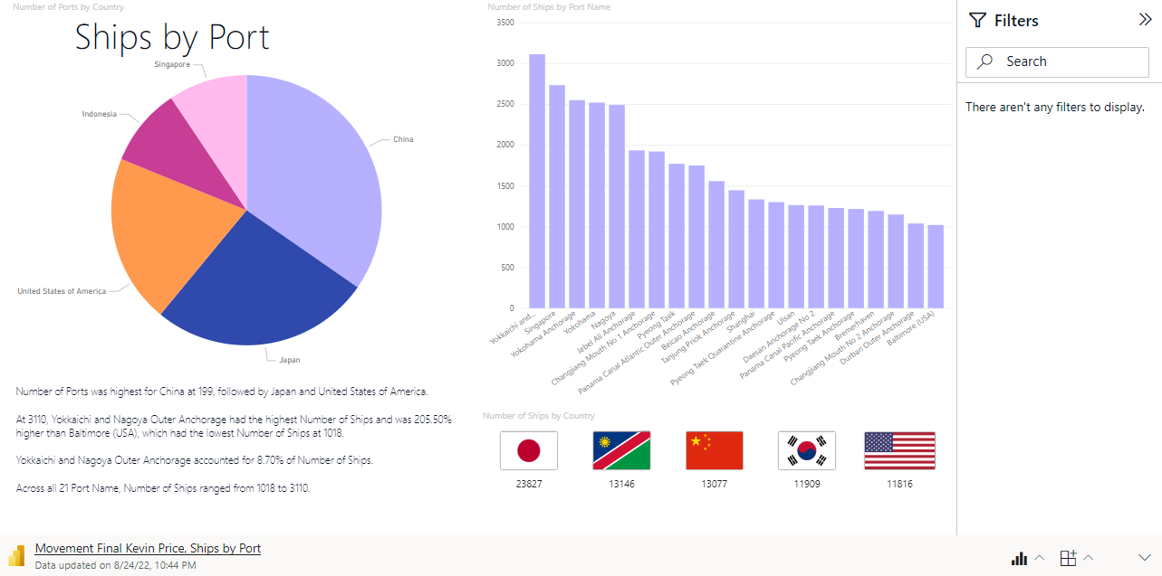
Microsoft Power BI

Slide 8
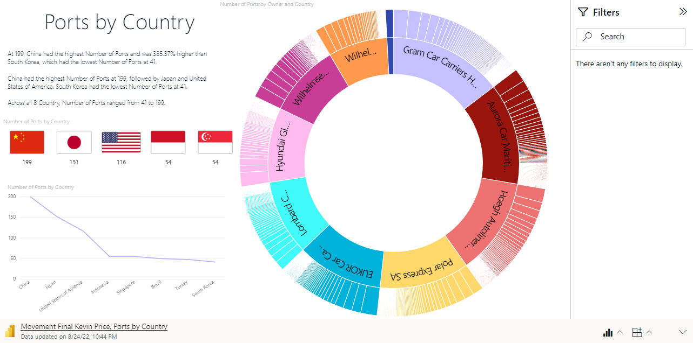
Microsoft Power BI

Slide 9
Summary/Conclusion
Flags of Convenience Dashboard
In conclusion, based on our data, it appears that due to auto-freight carriers being able to utilize flags of convenience, there is no true connection between the number of ships a country has compared to the number of ports.
Many countries choose to operate under the guise of a different country to reap the benefits of tax incentives or locality convenience and efficiency. Stakeholders should take interest in this method to reap these benefits.
The datasets represented, and my work done on them, is my first step into the world of data analytics.
Ultimately, I am looking to emerge into the field of data science and have interests to pursue a path either as a data scientist or data engineer.

Slide 10
Questions and Answers
(Q&A)

